Slide 1

Welcome to CS149 Students to….
THE FOURTH HOUR
TOPIC - Boolean Logic
Notes:
While students are filtering in, circulate a piece of paper for students to write their names on. Include a place for name and professor. If a student came in late, note what time they came in so that we can accurately track data. (The observing TA should probably be the one to manage and record when a student comes in late)

Slide 2
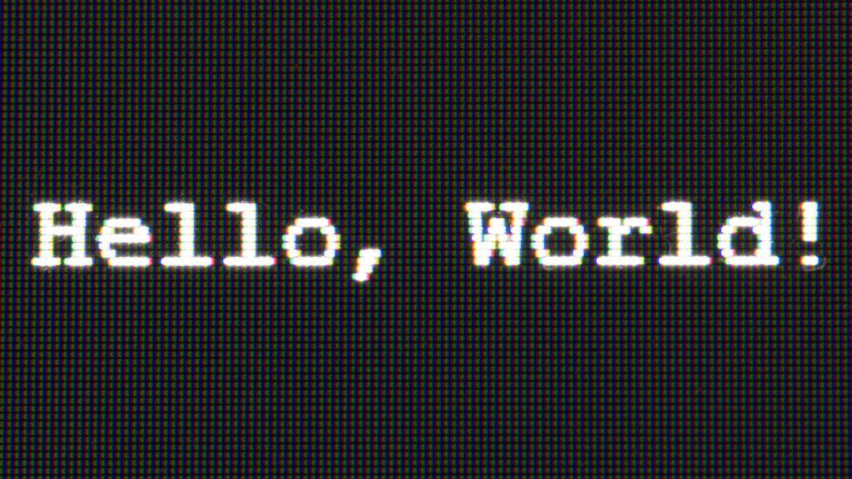
Introductions
Name
Professor
Fun Fact About yourself

Slide 3
What are boolean expressions?
Boolean expressions are statements that evaluate to true or false

Slide 4
What are boolean expressions?
Boolean expressions are statements that evaluate to true or false
We can store the values of boolean expressions in variables

Slide 5
What are boolean expressions?
Boolean expressions are statements that evaluate to true or false
We can store the values of boolean expressions in variables
boolean value = 100 > 5;

Slide 6
What are boolean expressions?
Boolean expressions are statements that evaluate to true or false
We can store the values of boolean expressions in variables
boolean value = 100 > 5;
We can print the values out

Slide 7
What are boolean expressions?
Boolean expressions are statements that evaluate to true or false
We can store the values of boolean expressions in variables
boolean value = 100 > 5;
We can print the values out
System.out.println(100 > 5); //prints out true

Slide 8
What are boolean expressions?
Boolean expressions are statements that evaluate to true or false
We can store the values of boolean expressions in variables:
boolean value = 100 > 5;
We can print the values out:
System.out.println(100 > 5); //prints out true
We can pass them through method calls:

Slide 9
What are boolean expressions?
Boolean expressions are statements that evaluate to true or false
We can store the values of boolean expressions in variables:
boolean value = 100 > 5;
We can print the values out:
System.out.println(100 > 5); //prints out true
We can pass them through method calls:
myMethod(100 > 5);

Slide 10
What are boolean expressions?
Boolean expressions are statements that evaluate to true or false
We can store the values of boolean expressions in variables:
boolean value = 100 > 5;
We can print the values out:
System.out.println(100 > 5); //prints out true
We can pass them through method calls:
myMethod(100 > 5);

Slide 11
What are boolean expressions?
Boolean expressions are statements that evaluate to true or false
We can store the values of boolean expressions in variables:
boolean value = 100 > 5;
We can print the values out:
System.out.println(100 > 5); //prints out true
We can pass them through method calls:
myMethod(100 > 5);
Or more commonly, use them in conditional statements (such as if, else if, else)

Slide 12
What are boolean expressions?
Boolean expressions are statements that evaluate to true or false
We can store the values of boolean expressions in variables:
boolean value = 100 > 5;
We can print the values out:
System.out.println(100 > 5); //prints out true
We can pass them through method calls:
myMethod(100 > 5);
Or more commonly, use them in conditional statements (such as if, else if, else)
if (100 > 5) { System.out.println(“true!” };

Slide 13
Activity time! : boolean matching
Break off into groups of 2-3 to complete the sorting activity.

Slide 14
Going over the Solution
Invalid Operators
=>
=<
!==
AND
OR

Slide 15
Going over the solution
There are 6 relational binary operators

Slide 16
Going over the solution
There are 6 relational binary operators
== equal
!= not equal
< less than
> greater than
<= less than or equal to
>= greater than or equal to

Slide 17
Going over the Solution
There are 3 logical operators
!
&&
||

Slide 18
Going over the Solution
There are 3 logical operators
!
&& Both must be true
|| One or the other must be true
We will go over more about these logical operators after this activity

Slide 19
Socrative Question 1
Go to https://b.socrative.com/login/student
Classroom name: FOURTHOUR

Slide 20
Socrative Question 1
What is the value of bool:
boolean a = 100 >= 100;
boolean b = 5 > 5;
boolean bool = a && b;
true
false
100
5
AND

Slide 21
Socrative Question 1
What is the value of bool:
boolean a = 100 >= 100;
boolean b = 5 > 5;
boolean bool = a && b;
true
false
100
5
AND

Slide 22
&& table
&& | true | false
true
false

Slide 23
&& table
true && true
&& | true | false
true
false

Slide 24
&& table
true && true -> true
&& | true | false
true
false

Slide 25
&& table
true && true -> true
&& | true | false
true | true
false

Slide 26
&& table
true && false
&& | true | false
true | true
false

Slide 27
&& table
true && false -> false
&& | true | false
true | true
false

Slide 28
&& table
true && false -> false
&& | true | false
true | true | false
false

Slide 29
&& table
false && true
&& | true | false
true | true | false
false

Slide 30
&& table
false && true -> false
&& | true | false
true | true | false
false | false
Notes:
Talk about short circuiting here. It sees the false first and doesn’t even go to the true

Slide 31
&& table
false && false
&& | true | false
true | true | false
false | false
Notes:
Talk about short circuiting here. It sees the false first and doesn’t even go to the second false

Slide 32
&& table
false && false -> false
&& | true | false
true | true | false
false | false
Notes:
Talk about short circuiting here. It sees the false first and doesn’t even go to the second false

Slide 33
&& table
false && false -> false
&& | true | false
true | true | false
false | false | false
Notes:
Talk about short circuiting here. It sees the false first and doesn’t even go to the second false

Slide 34
Solving the problem
boolean a = 100 >= 100;
boolean b = 5 > 5;
boolean bool = a && b;
What is the value of a?

Slide 35
Solving the problem
boolean a = 100 >= 100;
boolean b = 5 > 5;
boolean bool = a && b;
What is the value of a?
Is 100 greater than or equal to 100

Slide 36
Solving the problem
boolean a = 100 >= 100;
boolean b = 5 > 5;
boolean bool = a && b;
What is the value of a?
Is 100 greater than or equal to 100
true

Slide 37
Solving the problem
boolean a = 100 >= 100;
boolean b = 5 > 5;
boolean bool = a && b;
What is the value of a?
Is 100 greater than or equal to 100
true
What is the value of b?

Slide 38
Solving the problem
boolean a = 100 >= 100;
boolean b = 5 > 5;
boolean bool = a && b;
What is the value of a?
Is 100 greater than or equal to 100
true
What is the value of b?
Is 5 greater than 5

Slide 39
Solving the problem
boolean a = 100 >= 100;
boolean b = 5 > 5;
boolean bool = a && b;
What is the value of a?
Is 100 greater than or equal to 100
true
What is the value of b?
Is 5 greater than 5
false

Slide 40
Solving the problem
boolean a = 100 >= 100; //true
boolean b = 5 > 5; //false
boolean bool = a && b; //bool = true && false;
&& | true | false
true | true | false
false | false | false

Slide 41
Solving the problem
boolean a = 100 >= 100; //true
boolean b = 5 > 5; //false
boolean bool = a && b; //bool = true && false;
&& | true | false
true | true | false
false | false | false

Slide 42
Socrative Question 2
What is the value of bool?
boolean a = 100 >= 100;
boolean b = 5 > 5;
boolean bool = a || b;
true
false
100
5
OR

Slide 43
Socrative Question 2
What is the value of bool?
boolean a = 100 >= 100;
boolean b = 5 > 5;
boolean bool = a || b;
true
false
100
5
OR

Slide 44
|| table
true || true
|| | true | false
true
false

Slide 45
|| table
true || true -> true
|| | true | false
true
false

Slide 46
|| table
true || true -> true
|| | true | false
true | true
false

Slide 47
|| table
true || false
|| | true | false
true | true
false

Slide 48
|| table
true || false -> true
|| | true | false
true | true
false

Slide 49
|| table
true || false -> true
|| | true | false
true | true | true
false

Slide 50
|| table
false || true
|| | true | false
true | true | true
false

Slide 51
|| table
false || true -> true
|| | true | false
true | true | true
false | true

Slide 52
|| table
false || false
|| | true | false
true | true | true
false | true

Slide 53
|| table
false || false -> false
|| | true | false
true | true | true
false | true

Slide 54
|| table
false || false -> false
|| | true | false
true | true | true
false | true | false

Slide 55
Solving the problem
boolean a = 100 >= 100; //true
boolean b = 5 > 5; //false
boolean bool = a || b; //bool = true || false;

Slide 56
Solving the problem
boolean a = 100 >= 100; //true
boolean b = 5 > 5; //false
boolean bool = a || b; //bool = true || false;
|| | true | false
true | true | true
false | true | false

Slide 57
Solving the problem
boolean a = 100 >= 100; //true
boolean b = 5 > 5; //false
boolean bool = a || b; //bool = true || false;
|| | true | false
true | true | true
false | true | false

Slide 58
Time for another activity!
if (x && y) {
System.out.println(“yay!”); }
else if (y || x) { System.out.println(“right on!”);
}
else { System.out.println(“boo”);
}
Given the following solve
The problems in the boxes:
boolean x = 5 != 10;
boolean y = !(5 == 5);
System.out.println(x);
System.out.println(y);
if (y || 8 % 2 == 0)
{
System.out.println(“here”);
if (11 % 2 != 1)
{
System.out.println(“there”); }
System.out.println(“everywhere”);
}
else {
System.out.println(“end”); }
Notes:
Have students break off into groups of 2-3 and complete the following exercises.

Slide 59
Answer time!
boolean x = 5 != 10;
boolean y = !(5 == 5);
System.out.println(x);
System.out.println(y);

Slide 60
Answer time!
boolean x = 5 != 10; //is 5 not equal to 10
boolean y = !(5 == 5);
System.out.println(x);
System.out.println(y);

Slide 61
Answer time!
boolean x = 5 != 10; //true
boolean y = !(5 == 5);
System.out.println(x);
System.out.println(y);

Slide 62
Answer time!
boolean x = 5 != 10; //true
boolean y = !(5 == 5);
First we evaluate 5 == 5 (is 5 equal to 5)
System.out.println(x);
System.out.println(y);

Slide 63
Answer time!
boolean x = 5 != 10; //true
boolean y = !(5 == 5);
First we evaluate 5 == 5 (is 5 equal to 5) -> true
System.out.println(x);
System.out.println(y);

Slide 64
Answer time!
boolean x = 5 != 10; //true
boolean y = !(5 == 5);
First we evaluate 5 == 5 (is 5 equal to 5) -> true
! (the not symbol) makes !(true) the opposite (true turns into false)
System.out.println(x);
System.out.println(y);

Slide 65
Answer time!
boolean x = 5 != 10; //true
boolean y = !(5 == 5); //false
System.out.println(x);
System.out.println(y);

Slide 66
Answer time!
boolean x = 5 != 10; //true
boolean y = !(5 == 5); //false
System.out.println(x);
System.out.println(y);
true
false

Slide 67
Answer time!
if (x && y) {
System.out.println(“yay!”); }
else if (y || x) { System.out.println(“right on!”);
}
else { System.out.println(“boo”);
}
boolean x = 5 != 10; //true
boolean y = !(5 == 5); //false

Slide 68
Answer time!
if (x && y) { //true && false
System.out.println(“yay!”); }
else if (y || x) { System.out.println(“right on!”);
}
else { System.out.println(“boo”);
}
boolean x = 5 != 10; //true
boolean y = !(5 == 5); //false

Slide 69
Answer time!
if (x && y) { //true && false
System.out.println(“yay!”); }
else if (y || x) { //false || true System.out.println(“right on!”);
}
else { System.out.println(“boo”);
}
boolean x = 5 != 10; //true
boolean y = !(5 == 5); //false
right on!

Slide 70
Answer time!
if (x && y) { //true && false
System.out.println(“yay!”); }
else if (y || x) { //false || true System.out.println(“right on!”);
}
else { System.out.println(“boo”);
}
boolean x = 5 != 10; //true
boolean y = !(5 == 5); //false
right on!

Slide 71
Answer Time!
if (y || 8 % 2 == 0) //false || 8 % 2 == 0
{
System.out.println(“here”);
if (11 % 2 != 1)
{
System.out.println(“there”); }
System.out.println(“everywhere”);
}
else {
System.out.println(“end”); }
boolean x = 5 != 10; //true
boolean y = !(5 == 5); //false

Slide 72
Answer Time!
if (y || 8 % 2 == 0) //false || true
{
System.out.println(“here”);
if (11 % 2 != 1)
{
System.out.println(“there”); }
System.out.println(“everywhere”);
}
else {
System.out.println(“end”); }
boolean x = 5 != 10; //true
boolean y = !(5 == 5); //false

Slide 73
Answer Time!
if (y || 8 % 2 == 0) //false || true
{
System.out.println(“here”);
if (11 % 2 != 1)
{
System.out.println(“there”); }
System.out.println(“everywhere”);
}
else {
System.out.println(“end”); }
boolean x = 5 != 10; //true
boolean y = !(5 == 5); //false
here

Slide 74
Answer Time!
if (y || 8 % 2 == 0) //false || true
{
System.out.println(“here”);
if (11 % 2 != 1) //false
{
System.out.println(“there”); }
System.out.println(“everywhere”);
}
else {
System.out.println(“end”); }
boolean x = 5 != 10; //true
boolean y = !(5 == 5); //false
here
everywhere

Slide 75
Answer Time!
if (y || 8 % 2 == 0) //false || true
{
System.out.println(“here”);
if (11 % 2 != 1) //false
{
System.out.println(“there”); }
System.out.println(“everywhere”);
}
else {
System.out.println(“end”); }
boolean x = 5 != 10; //true
boolean y = !(5 == 5); //false
here
everywhere

Slide 76
Socrative Question 3
Which are examples of short circuiting:
10 < 5 || 5 == 5
5 == 5 || 10 < 5
10 < 5 && 5 == 5
5 == 5 && 10 < 5
A and B
C and D
B and C
All of the above

Slide 77
Socrative Question 3
Which are examples of short circuiting:
10 < 5 || 5 == 5
5 == 5 || 10 < 5
10 < 5 && 5 == 5
5 == 5 && 10 < 5
A and B
C and D
B and C
All of the above

Slide 78
Short Circuiting
Occurs when a boolean expression doesn’t have to be fully evaluated
In cases of || if the first item is true the expression is short-circuited

Slide 79
Short Circuiting
Occurs when a boolean expression doesn’t have to be fully evaluated
In cases of || if the first item is true the expression is short-circuited
Why?

Slide 80
Short Circuiting
Occurs when a boolean expression doesn’t have to be fully evaluated
In cases of || if the first item is true the expression is short-circuited
Why?
Only one thing in the || statement has to be true for it to evaluate to true

Slide 81
Short Circuiting
Occurs when a boolean expression doesn’t have to be fully evaluated
In cases of || if the first item is true the expression is short-circuited
Why?
Only one thing in the || statement has to be true for it to evaluate to true
Ex. 5 == 5 || 10 < 5

Slide 82
Short Circuiting
Occurs when a boolean expression doesn’t have to be fully evaluated
In cases of || if the first item is true the expression is short-circuited
Why?
Only one thing in the || statement has to be true for it to evaluate to true
Ex. 5 == 5 || 10 < 5
5 == 5 evaluates to true so the expression is short circuited

Slide 83
Short Circuiting
Occurs when a boolean expression doesn’t have to be fully evaluated
In cases of || if the first item is true the expression is short-circuited
Why?
Only one thing in the || statement has to be true for it to evaluate to true
Ex. 5 == 5 || 10 < 5
5 == 5 evaluates to true so the expression is short circuited
In cases of && when the first item is false the expression is short-circuited

Slide 84
Short Circuiting
Occurs when a boolean expression doesn’t have to be fully evaluated
In cases of || if the first item is true the expression is short-circuited
Why?
Only one thing in the || statement has to be true for it to evaluate to true
Ex. 5 == 5 || 10 < 5
5 == 5 evaluates to true so the expression is short circuited
In cases of && when the first item is false the expression is short-circuited
Why?

Slide 85
Short Circuiting
Occurs when a boolean expression doesn’t have to be fully evaluated
In cases of || if the first item is true the expression is short-circuited
Why?
Only one thing in the || statement has to be true for it to evaluate to true
Ex. 5 == 5 || 10 < 5
5 == 5 evaluates to true so the expression is short circuited
In cases of && when the first item is false the expression is short-circuited
Why?
Only one thing in && statement has to be false for it to evaluate to false
Ex. 10 < 5 && 5 == 5

Slide 86
Short Circuiting
Occurs when a boolean expression doesn’t have to be fully evaluated
In cases of || if the first item is true the expression is short-circuited
Why?
Only one thing in the || statement has to be true for it to evaluate to true
Ex. 5 == 5 || 10 < 5
5 == 5 evaluates to true to the expression is short circuited
In cases of && when the first item is false the expression is short-circuited
Why?
Only one thing in && statement has to be false for it to evaluate to false
Ex. 10 < 5 && 5 == 5
10< 5 evaluates to false so the expression is short circuited

Slide 87

Questions

